Slide 1
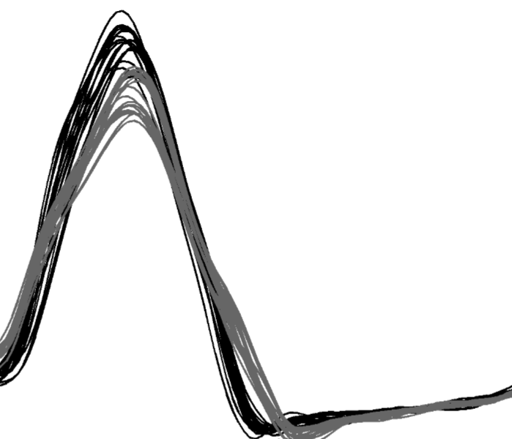
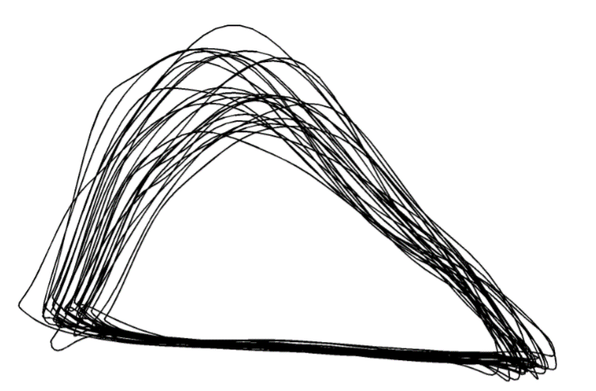
Advanced Statistical Analysis of Biomechanical Time Series
Principal Components Analysis
Functional Data Analysis
Statistical Parametric Mapping
Todd Pataky
Mark Robinson
Drew Harrison
John Warmenhoven
Department of Health and Human Sciences, Kyoto University
Research Institute for Sport and Exercise Sciences, Liverpool John Moores University
Physical Education and Sport Sciences, University of Limerick
Exercise & Sports Science, University of Sydney

Slide 2
Testing Predictions
Finding Patterns
Science
Engineering
Classical Hypothesis Testing
Bayesian Approaches
Dimensionality Reduction
Machine Learning
0D or Discrete
PCA
ICA
kPCA
ANN
SVM
SOM
MANCOVA
Statistical Parametric Mapping
PCA of Waveforms
1D or Continua
Statistical Non-Parametric Mapping
Functional Data Analysis
Notes:
Talk people through this slide as an introduction to the broad differences between PCA, FDA and SPM.

Slide 3
Functional Data Analysis (FDA)
Data points on a time-series are considered as a single entity.
Assumed to be generated by some relatively smooth underlying function.
Involves fitting basis expansions to time-series data (B-Splines, Fourier, etc.).
High control over smoothing and registration of data if it is necessary.
Extrapolation to conventional multivariate statistical practices.
Notes:
Talk to this slide.

Slide 4
Functional Data Analysis (FDA)
Data points on a time-series are considered as a single entity.
Assumed to be generated by some relatively smooth underlying function.
Involves fitting basis expansions to time-series data (B-Splines, Fourier, etc.).
High control over smoothing and registration of data if it is necessary.
Extrapolation to conventional multivariate statistical practices.
General FDA Steps:
Fitting functions with the addition of smoothing using a roughness penalty.
Registration techniques using time-warping functions.
The implementation of statistical techniques such as hypothesis testing (t-tests, ANOVAs, regressions, etc.), or dimension reduction approaches (PCA, etc.).
Functional PCA (fPCA) is the most commonly used in biomechanics and human movement.
Notes:
Talk to this slide.

Slide 5
Functional Data Analysis (FDA)
Number of approaches for fitting functions are available, and some common approaches are:
Fourier:
Stable functions (i.e. strong local features and where the curvature tends to be of the same order).
Periodicity of the signal be reflected to some degree in the data.
B-Splines:
Spline functions are the most common choice of approximation system for non-periodic functional data or parameters.
Derived from polynomials, with increased flexibility around unstable local behaviour.
General FDA Steps:
Fitting functions with the addition of smoothing using a roughness penalty.
Registration techniques using time-warping functions.
The implementation of statistical techniques such as hypothesis testing (t-tests, ANOVAs, regressions, etc.), or dimension reduction approaches (PCA, etc.).
Functional PCA (fPCA) is the most commonly used in biomechanics and human movement.
Fourier and B-Spline fitting processes are demonstrated in Warmenhoven et al. (2017).
Notes:
Also mention other basis expansions such as wavelets and polynomials.

Slide 6
Functional Data Analysis (FDA)
General FDA Steps:
Fitting functions with the addition of smoothing using a roughness penalty.
Registration techniques using time-warping functions.
The implementation of statistical techniques such as hypothesis testing (t-tests, ANOVAs, regressions, etc.), or dimension reduction approaches (PCA, etc.).
Functional PCA (fPCA) is the most commonly used in biomechanics and human movement.
Fourier and B-Spline fitting processes are demonstrated in Warmenhoven et al. (2017).
Notes:
Quick example of how fitting can be affected after truncating data, and the difference in handling this between Fourier and B-Splines.

Slide 7
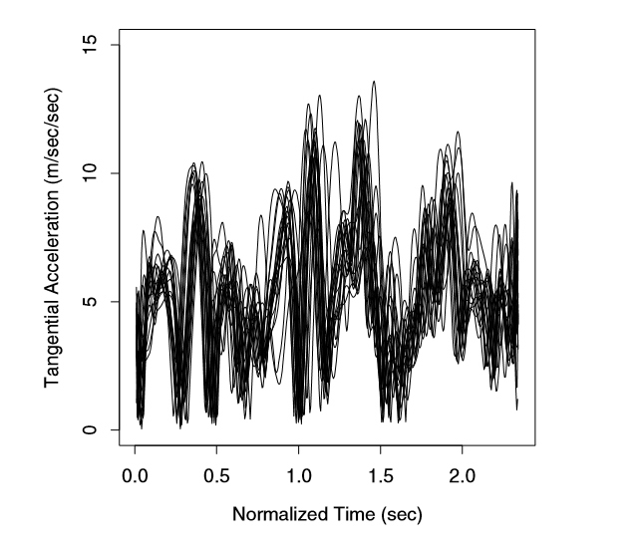
Functional Data Analysis (FDA)
General FDA Steps:
Fitting functions with the addition of smoothing using a roughness penalty.
Registration techniques using time-warping functions.
The implementation of statistical techniques such as hypothesis testing (t-tests, ANOVAs, regressions, etc.), or dimension reduction approaches (PCA, etc.).
Functional PCA (fPCA) is the most commonly used in biomechanics and human movement.
Handwriting data from Ramsay & Silverman (2002).
Notes:
Explain the concept of registration:
Controlling for either amplitude or phase variation (with phase variation being more commonly controlled for).
Talk to the temporal shifts in the handwriting graph.

Slide 8
Functional Data Analysis (FDA)
General FDA Steps:
Fitting functions with the addition of smoothing using a roughness penalty.
Registration techniques using time-warping functions.
The implementation of statistical techniques such as hypothesis testing (t-tests, ANOVAs, regressions, etc.), or dimension reduction approaches (PCA, etc.).
Functional PCA (fPCA) is the most commonly used in biomechanics and human movement.
Handwriting data from Ramsay & Silverman (2002).
Notes:
Explain the concept of registration:
Controlling for either amplitude or phase variation (with phase variation being more commonly controlled for).
Talk to the temporal shifts in the handwriting graph.

Slide 9
Functional Data Analysis (FDA)
General FDA Steps:
Fitting functions with the addition of smoothing using a roughness penalty.
Registration techniques using time-warping functions.
The implementation of statistical techniques such as hypothesis testing (t-tests, ANOVAs, regressions, etc.), or dimension reduction approaches (PCA, etc.).
Functional PCA (fPCA) is the most commonly used in biomechanics and human movement.
Handwriting data from Ramsay & Silverman (2002).
Notes:
Explain the concept of registration:
Controlling for either amplitude or phase variation (with phase variation being more commonly controlled for).
Talk to the temporal shifts in the handwriting graph.

Slide 10
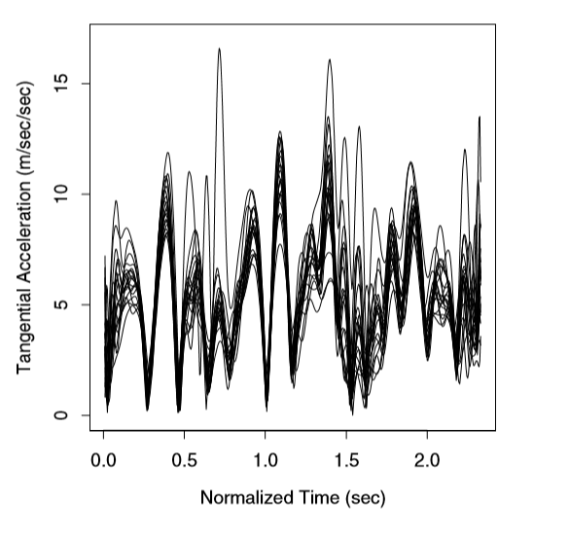
Functional Data Analysis (FDA)
General FDA Steps:
Fitting functions with the addition of smoothing using a roughness penalty.
Registration techniques using time-warping functions.
The implementation of statistical techniques such as hypothesis testing (t-tests, ANOVAs, regressions, etc.), or dimension reduction approaches (PCA, etc.).
Functional PCA (fPCA) is the most commonly used in biomechanics and human movement.
Handwriting data from Ramsay & Silverman (2002).
Notes:
Explain the concept of registration:
Controlling for either amplitude or phase variation (with phase variation being more commonly controlled for).
Talk to the temporal shifts in the handwriting graph.

Slide 11
Functional Data Analysis (FDA)
General FDA Steps:
Fitting functions with the addition of smoothing using a roughness penalty.
Registration techniques using time-warping functions.
The implementation of statistical techniques such as hypothesis testing (t-tests, ANOVAs, regressions, etc.), or dimension reduction approaches (PCA, etc.).
Functional PCA (fPCA) is the most commonly used in biomechanics and human movement.
Handwriting data from Ramsay & Silverman (2002).
Notes:
A quick mention here that there are different methods of curve registration such as landmark and global registration.
Both of these approaches are within the software package provided by Ramsay and Silverman on the FDA website.

Slide 12
Testing Predictions
Finding Patterns
Science
Engineering
Classical Hypothesis Testing
Bayesian Approaches
Dimensionality Reduction
Machine Learning
0D or Discrete
PCA
ICA
kPCA
ANN
SVM
SOM
MANCOVA
Statistical Parametric Mapping
PCA of Waveforms
1D or Continua
Statistical Non-Parametric Mapping
Functional Data Analysis
Notes:
Re-iterate that FDA goes across both testing predictions and finding patterns.

Slide 13
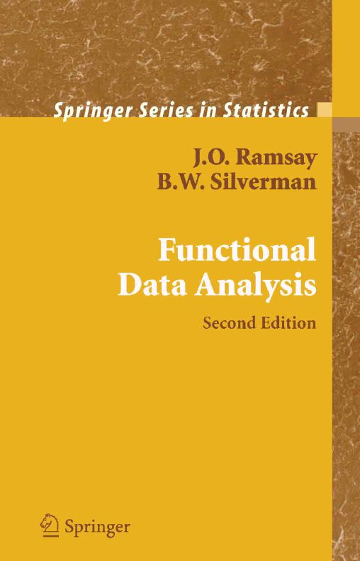
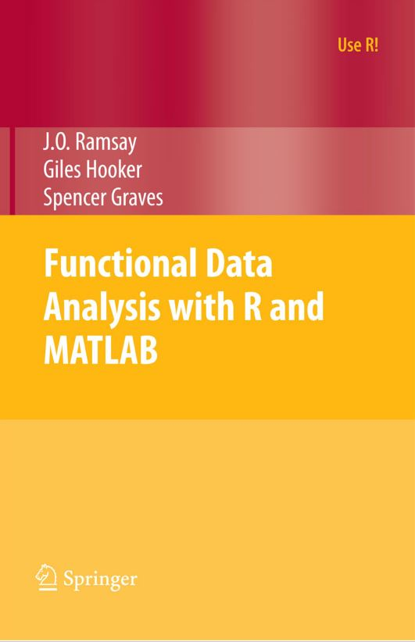
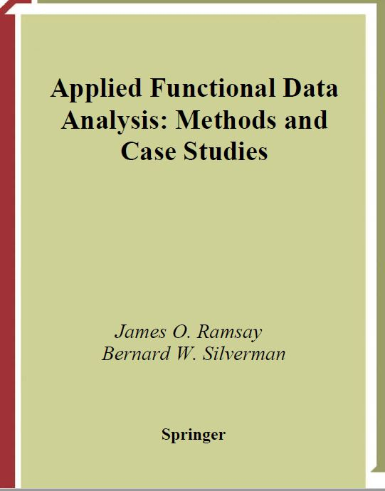
FDA Techniques
Ramsay & Silverman (2005)
Ramsay & Silverman (2002)
Ramsay, Hooker & Graves (2009)
Finding patterns and exploring variability
Functional Principal Components Analysis (fPCA)
Functional Canonical Correlation Analysis (fCCA)
Testing predictions
Functional Linear Models (FLM)
Functional Predictor > Scalar Outcome
Scalar Predictor > Functional Outcome
Functional Predictor > Functional Outcome
Principal Differential Analysis (PDA)
Notes:
Introduce these techniques briefly but also mention that these come from the early developments of FDA captured in these three texts.

Slide 14
FDA Techniques
Finding patterns and exploring variability
Functional Principal Components Analysis (fPCA)
Functional Canonical Correlation Analysis (fCCA)
Testing predictions
Functional Linear Models (FLM)
Functional Predictor > Scalar Outcome
Scalar Predictor > Functional Outcome
Functional Predictor > Functional Outcome
Principal Differential Analysis (PDA)
Notes:
fPCA
Touch on this briefly, but go through in more detail later in the presentation.
CCA
A functional version of canonical correlation analysis, identifying components of variability in each of the two sets of observations which are highly correlated with one another.
FLM
An interesting application of FDA involves the construction of functional models that describe the relation between an outcome variable and an explanatory variable. Such models are termed functional linear models (FLMs). In functional linear models, the functions could be the outcome or the predictors or both (Ullah & Finch, 2013).
Because of the nature of functional statistics, it is difficult to attempt to derive a theoretical null distribution for any given test statistic since we would need to account for selecting a smoothing parameter as well as the smoothing itself. Instead, the package employs a permutation test methodology. This involves constructing a null distribution from the observed data directly. If there is no relationship between the response and the covariates, it should make no difference if we randomly rearrange the way they are paired. To see what a result might look in this case, we can simply perform the experiment of rearranging the vector of responses while keeping the covariates in the same order and trying to fit the model again. The advantage of this is that we no longer need to rely on distributional assumptions. The disadvantage is that we cannot test for the significance of an individual covariate among many models (Ramsay, Hooker & Graves, 2009).
PDA
A PDA model looks for a linear differential operator to represent covariation between x and Dx. This method has been labelled principal differential analysis (PDA)
because of its similarity to principal components analysis. Functional PCA looked for linear operators to explain variation between curves. In contrast, PDA looks for linear operators to explain variation between derivatives but within curves.

Slide 15
FDA Techniques
Finding patterns and exploring variability
Functional Principal Components Analysis (fPCA)
Functional Canonical Correlation Analysis (fCCA)
Testing predictions
Functional Linear Models (FLM)
Functional Predictor > Scalar Outcome
Scalar Predictor > Functional Outcome
Functional Predictor > Functional Outcome
Principal Differential Analysis (PDA)
Displays dominant modes of variation in data.
Provides outputs relative to each mode of variation that allow for patterns to be tested relative to research questions.
This is the most common FDA technique used in applied in biomechanics, with use in:
Jumping (Ryan, Harrison & Hayes, 2007).
Race-walking (Dona, Preatoni, Cobelli, Rodano & Harrison, 2009).
Rowing (Warmenhoven et al., 2017)
Gait (Donoghue, Harrison, Coffey, & Hayes, 2008).
Weightlifting (Kipp & Harris, 2014).
Notes:
Talk to this slide.

Slide 16
FDA Techniques
Finding patterns and exploring variability
Functional Principal Components Analysis (fPCA)
Functional Canonical Correlation Analysis (fCCA)
Testing predictions
Functional Linear Models (FLM)
Functional Predictor > Scalar Outcome
Scalar Predictor > Functional Outcome
Functional Predictor > Functional Outcome
Principal Differential Analysis (PDA)
Identifies components of variability present in each of two sets of observations, which are highly correlated with one another.
Great potential for coordination research.
Relatively underutilised in biomechanics research.
A good example of biomechanical application is Leurgans, Moyeed & Silverman (1993), with use in paediatric gait analysis.
Notes:
Talk to this slide.

Slide 17
FDA Techniques
Finding patterns and exploring variability
Functional Principal Components Analysis (fPCA)
Functional Canonical Correlation Analysis (fCCA)
Testing predictions
Functional Linear Models (FLM)
Functional Predictor > Scalar Outcome
Scalar Predictor > Functional Outcome
Functional Predictor > Functional Outcome
Principal Differential Analysis (PDA)
Applying the framework of the general linear model to functional data.
These describe the relationship between outcome variables and an explanatory variables.
In biomechanics research the following techniques have been applied:
Functional t-tests in ACL jumping research (Baumgart, Hoppe & Freiwald, 2017).
Functional ANOVAs in gait under pain effusion (Park, Seeley, Francom, Reese & Hopkins , 2017).
Functional Regressions in gait exploring the effects of walking velocity (Dura et al., 2010).
Notes:
Talk to this slide.

Slide 18
FDA Techniques
Finding patterns and exploring variability
Functional Principal Components Analysis (fPCA)
Functional Canonical Correlation Analysis (fCCA)
Testing predictions
Functional Linear Models (FLM)
Functional Predictor > Scalar Outcome
Scalar Predictor > Functional Outcome
Functional Predictor > Functional Outcome
Principal Differential Analysis (PDA)
Has applications to both “finding patterns” and “testing predictions”
In the context of dimension reduction:
fPCA looks for linear operators to explain variation between curves.
PDA looks for linear operators to explain variation between derivatives but within curves.
For FLMs, a PDA model looks for a linear differential operator to represent covariation between a variable (x) and its derivative (Dx).
This is largely underexplored in the context of biomechanical research themes and contexts.
Notes:
Some additional notes on PDA:
A PDA model looks for a linear differential operator to represent covariation between x and Dx. This method has been labelled principal differential analysis (PDA) because of its similarity to principal components analysis. Functional PCA looked for linear operators to explain variation between curves. In contrast, PDA looks for linear operators to explain variation between derivatives but within curves.

Slide 19
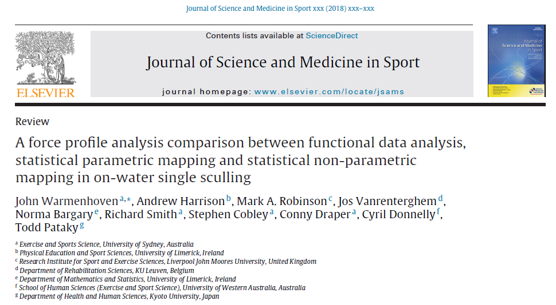
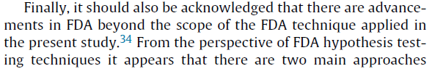
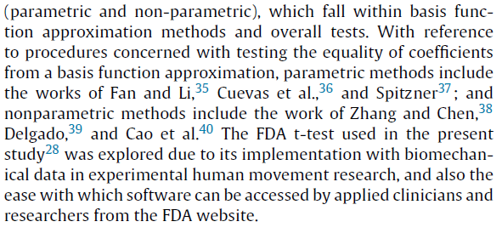
FDA Techniques
Extensions beyond Ramsay & Silverman…
Notes:
Communicate to the audience that there are far more advanced extensions of FDA beyond the techniques in those three texts and also beyond the techniques mentioned and explored in this workshop.
We are focusing on these early methods of Ramsay and colleagues due to the accessibility of the software and the clarity in following the methods (using the books, etc.). So from a practitioner perspective this is easier.

Slide 20
Finding Patterns with PCA and fPCA
Data used to describe these techniques come from sample data set one in Warmenhoven et al. (2017).
National
International
PCA of Waveforms and fPCA can be described together…
Step
Representation of data
Smoothing
Control for phase variation
PCA of Waveforms
Data points
Filtering as a part of pre-processing
Piecewise spline interpolation
fPCA
Coefficients of a function
Smoothing parameter applied during function fitting
Curve registration using time warping functions
Notes:
Talk to this slide.
Mention that data preparation, smoothing and phase variation control methods can be used interchangeably between the two PCAs, but those listed on the slide are what they are more commonly paired with.

Slide 21
Finding Patterns with PCA and fPCA
Data used to describe these techniques come from sample data set one in Warmenhoven et al. (2017).
PCA of Waveforms and fPCA can be described together…
Step
Mean of curves
PCA of Waveforms
Data points
fPCA
Coefficients of a function

Slide 22
Finding Patterns with PCA and fPCA
Data used to describe these techniques come from sample data set one in Warmenhoven et al. (2017).
Variance matrix calculated as a step in deriving the covariance matrix
PCA of Waveforms and fPCA can be described together…
Step
Mean of curves
Variability structures in the original data
PCA of Waveforms
Data points
Covariance matrix
fPCA
Coefficients of a function
Covariance function
Notes:
Check from here onwards with Norma.

Slide 23
Finding Patterns with PCA and fPCA
Data used to describe these techniques come from sample data set one in Warmenhoven et al. (2017).
PCA of Waveforms and fPCA can be described together…
Step
Orthogonal decomposition
Proportion of variability
PCA of Waveforms
Eigenvectors (PCs)
Eigenvalues used to calculate % variation of each PC
fPCA
Eigenfunctions (fPCs)
Eigenvalues used to calculate % variation of each fPC
Notes:
Check from here onwards with Norma.
Eigenvalues are elements of the diagonal covariance matrix after an orthogonal decomposition. Eigenvalues are also an outcome of FDA (fPCA)? Check this…
Number of PCs retained is equal to the number of data points on a curve.
Number of fPCs retained is equal to the number of…

Slide 24
Finding Patterns with PCA and fPCA
Data used to describe these techniques come from sample data set one in Warmenhoven et al. (2017).
Interpreting variability that is shown by PCA of Waveforms and fPCA…
Retain the mean vector (PCA) or function (fPCA) from the original data.

Slide 25
Finding Patterns with PCA and fPCA
Data used to describe these techniques come from sample data set one in Warmenhoven et al. (2017).
Interpreting variability that is shown by PCA of Waveforms and fPCA…
Retain the mean vector (PCA) or function (fPCA) from the original data.
Add…

Slide 26
Finding Patterns with PCA and fPCA
Data used to describe these techniques come from sample data set one in Warmenhoven et al. (2017).
This process of visualization can be implemented in an identical way for both PCA and fPCA.
Interpreting variability that is shown by PCA of Waveforms and fPCA…
Retain the mean vector (PCA) or function (fPCA) from the original data.
Add… and subtract the PC vector or fPC function from the mean.
Plot the addition of the PC/fPC intuitively using “+” and the subtraction using “–” symbols.
A constant (c) can be used to scale the size of each PC or fPC when plotted relative to the mean.
Notes:
Talk to this slide.

Slide 27
Finding Patterns with PCA and fPCA
Data used to describe these techniques come from sample data set one in Warmenhoven et al. (2017).
PCA of Waveforms and fPCA can be described together…
Step
Weights relative to PCs/fPCs
PCA of Waveforms
PC scores
fPCA
fPC scores
Notes:
Check with Norma for the best way to describe scores.
Again talk to this slide.

Slide 28
Finding Patterns with PCA and fPCA
Data used to describe these techniques come from sample data set one in Warmenhoven et al. (2017).
Scores (PCA and fPCA) also carry a magnitude component…

Slide 29
Finding Patterns with PCA and fPCA
Data used to describe these techniques come from sample data set one in Warmenhoven et al. (2017).
Scores (PCA and fPCA) also carry a magnitude component…

Slide 30
Finding Patterns with PCA and fPCA
Data used to describe these techniques come from sample data set one in Warmenhoven et al. (2017).
Scores (PCA and fPCA) also carry a magnitude component…

Slide 31
Finding Patterns with PCA and fPCA
Data used to describe these techniques come from sample data set one in Warmenhoven et al. (2017).
Scores (PCA and fPCA) also carry a magnitude component…

Slide 32
Finding Patterns with PCA and fPCA
Data used to describe these techniques come from sample data set one in Warmenhoven et al. (2017).
Scores (PCA and fPCA) also carry a magnitude component…

Slide 33
Finding Patterns with PCA and fPCA
Data used to describe these techniques come from sample data set one in Warmenhoven et al. (2017).
Scores (PCA and fPCA) also carry a magnitude component…

Slide 34
Finding Patterns with PCA and fPCA
Data used to describe these techniques come from sample data set one in Warmenhoven et al. (2017).
Scores (PCA and fPCA) also carry a magnitude component…

Slide 35
Finding Patterns with PCA and fPCA
Data used to describe these techniques come from sample data set one in Warmenhoven et al. (2017).
PCA of Waveforms and fPCA can be described together…
Step
Weights relative to PCs/fPCs
PCA of Waveforms
PC scores
fPCA
fPC scores

Slide 36
Finding Patterns with PCA and fPCA
Data used to describe these techniques come from sample data set one in Warmenhoven et al. (2017).
PCA of Waveforms and fPCA can be described together…
Step
Weights relative to PCs/fPCs
PCA of Waveforms
PC scores
fPCA
fPC scores
Notes:
Each curve gets a score relative to each principal component.

Slide 37
Finding Patterns with PCA and fPCA
PCA and fPCA outputs come in two phases:
The PCs or fPCs
The scores
Practical
Apply conventional univariate or multivariate statistical practices to the scores:
Discriminant Function Analysis
Clustering (k-means, etc.).
Test
This is Figure 1 from Warmenhoven et al. (2017).
Notes:
Communicate to the audience that there is a biomechanically meaningful and practical part of the results, and also a part that allows you to test research questions.

Slide 38
Functional Linear Models
Ramsay, Hooker & Graves (2009)
Difficult to derive a theoretical null distribution for any given test statistic for functional data (Ramsay, Hooker & Graves, 2009)…
Need to account for:
Selection of a smoothing parameter
the smoothing itself
Package employs a permutation test methodology.
This involves constructing a null distribution from the observed data directly.
Executed by rearranging the vector of responses while keeping the covariates in the same order and trying to fit the model again.
The advantage of this is that we no longer need to rely on distributional assumptions.
The disadvantage is that we cannot test for the significance of an individual covariate among many.
Notes:
Talk to this slide.

Slide 39
Functional t-test
Male
Used to assess the simple experimental scenario of whether a difference exists between two independent groups.
Data taken from Warmenhoven et al. (2018) and looks at differences in gender for characteristics of force application in rowing.
After function fitting, smoothing and registration… functional descriptive statistics can be plotted and inspected relative to the results of the t-test.
Creation of a pointwise absolute t-statistic…
Provides a sense of the relative separation of the two groups of functions.
Female
Notes:
Talk to this slide.

Slide 40
Functional t-test
A formal hypothesis test requires:
value or statistic to test, and;
probability value indicating the result of the test
The test statistic used is the maximum value of the multivariate T-test, T(t).
Notes:
Talk to this slide.

Slide 41
Functional t-test
A formal hypothesis test requires:
value or statistic to test, and;
probability value indicating the result of the test
The test statistic used is the maximum value of the multivariate T-test, T(t).
To find a critical value of this statistic:
randomly shuffle the labels of the curves
recalculate the maximum of T(t) with the new labels
Repeating this many times allows a null distribution to be constructed.
Notes:
Talk to this slide.

Slide 42
Functional t-test
A formal hypothesis test requires:
value or statistic to test, and;
probability value indicating the result of the test
The test statistic used is the maximum value of the multivariate T-test, T(t).
To find a critical value of this statistic:
randomly shuffle the labels of the curves
recalculate the maximum of T(t) with the new labels
Repeating this many times allows a null distribution to be constructed.
Notes:
Talk to this slide.

Slide 43
Functional t-test
A formal hypothesis test requires:
value or statistic to test, and;
probability value indicating the result of the test
The test statistic used is the maximum value of the multivariate T-test, T(t).
To find a critical value of this statistic:
randomly shuffle the labels of the curves
recalculate the maximum of T(t) with the new labels
Repeating this many times allows a null distribution to be constructed.
Notes:
Talk to this slide.

Slide 44
Functional t-test
A formal hypothesis test requires:
value or statistic to test, and;
probability value indicating the result of the test
The test statistic used is the maximum value of the multivariate T-test, T(t).
To find a critical value of this statistic:
randomly shuffle the labels of the curves
recalculate the maximum of T(t) with the new labels
Repeating this many times allows a null distribution to be constructed.
Notes:
Talk to this slide.

Slide 45
References
Baumgart, C., Hoppe, M. W., & Freiwald, J. (2017). Phase-Specific Ground Reaction Force Analyses of Bilateral and Unilateral Jumps in Patients With ACL Reconstruction. Orthopaedic Journal of Sports Medicine, 5(6), 2325967117710912.
Dona, G., Preatoni, E., Cobelli, C., Rodano, R., & Harrison, A. J. (2009). Application of functional principal component analysis in race walking: an emerging methodology. Sports Biomechanics, 8(4), 284-301.
Donoghue, O. A., Harrison, A. J., Coffey, N., & Hayes, K. (2008). Functional data analysis of running kinematics in chronic Achilles tendon injury. Medicine and science in sports and exercise, 40(7), 1323-1335.
Durá, J. V., Belda, J. M., Poveda, R., Page, Á., Laparra, J., Das, J., . . . García, A. C. (2010). Comparison of functional regression and nonfunctional regression approaches to the study of the walking velocity effect in force platform measures. Journal of applied biomechanics, 26(2), 234-239.
Kipp, K., & Harris, C. (2014). Patterns of barbell acceleration during the snatch in weightlifting competition. Journal of sports sciences, 33(14), 1467-1471.
Leurgans, S. E., Moyeed, R. A., & Silverman, B. W. (1993). Canonical correlation analysis when the data are curves. Journal of the Royal Statistical Society. Series B (Methodological), 725-740.
Park, J., Seeley, M. K., Francom, D., Reese, C. S., & Hopkins, J. T. (2017). Functional vs. Traditional Analysis in Biomechanical Gait Data: An Alternative Statistical Approach. Journal of human kinetics, 60(1), 39-49.
Ramsay, J. O., Hooker, G., & Graves, S. (2009). Functional data analysis with R and MATLAB: Springer Science & Business Media.
Ramsay, J. O., & Silverman, B. W. (2002). Applied functional data analysis: methods and case studies (Vol. 77). New York: Springer.
Ramsay, J. O., & Silverman, B. W. (2005). Functional data analysis: Wiley Online Library.
Ryan, W., Harrison, A., & Hayes, K. (2006). Functional data analysis of knee joint kinematics in the vertical jump. Sports Biomechanics, 5(1), 121-138.
Warmenhoven, J., Cobley, S., Draper, C., Harrison, A. J., Bargary, N., & Smith, R. (2017). Considerations for the use of functional principal components analysis (fPCA) in sports biomechanics: examples from on-water rowing. Sports Biomechanics, In Press.
Warmenhoven, J., Harrison, A. J., Robinson, M. A., Vanrenterghem, J., Bargary, N., Smith, R., . . . Pataky, T. (2017). A comparison of functional data analysis and statistical parametric mapping in sports biomechanics: The independent samples t-test. Journal of Science & Medicine in Sport, In Press.
Notes:
Talk to this slide.

